Slide 1
EE542 Lab 4
Sufyan Shaikh
Charles Andre

Slide 2
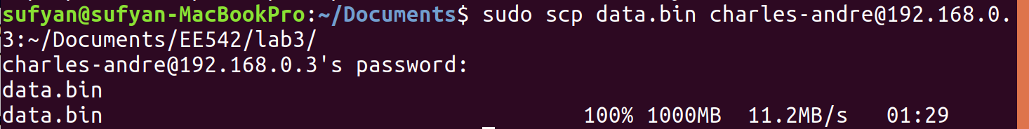
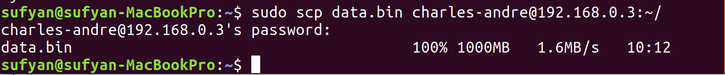
Default TCP on Lossy and High Delay Links
TCP, out of the box sucks at handling any sort of lossy or higher RTT links
We used SCP to send a 1GB file over links of varying delays and packet loss percentages
We expected really low throughput, because the TCP that came with our kernel is not designed with these sorts of high delay, lossy links in mind
However, for 200ms of delay and 25% packet loss, the file would not even begin to send-- the data rate was 0 MBps
10ms and 0%
50ms and 5%
100ms and 10% (we were not willing to wait 2+ hours for this to finish)

Slide 3
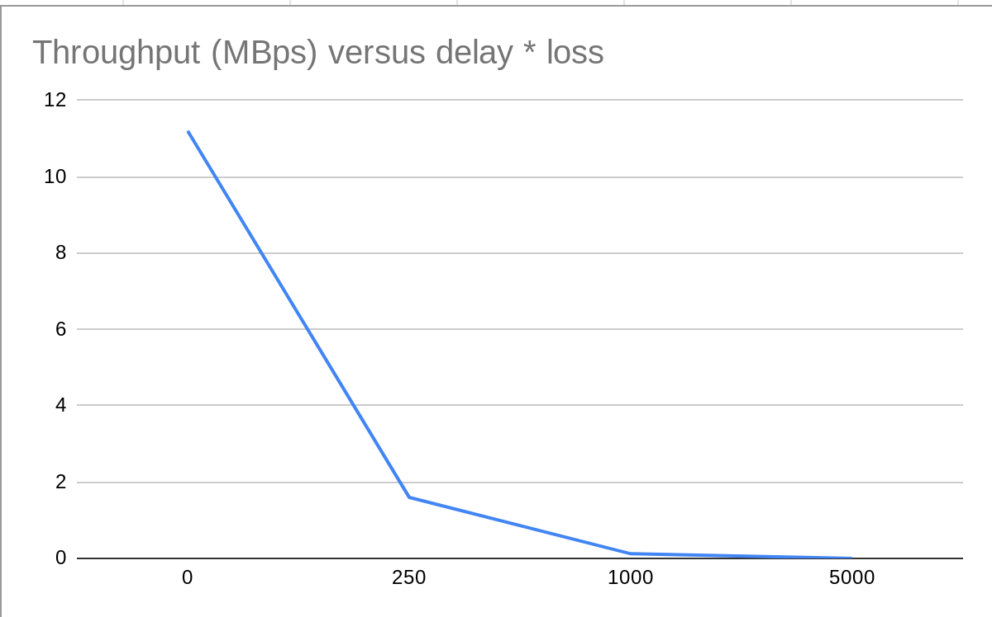
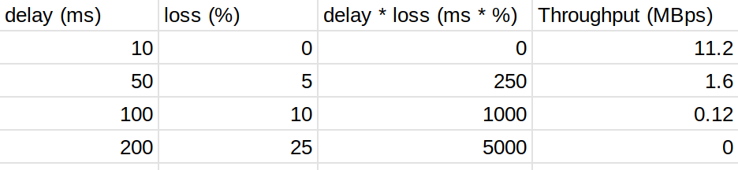
Default TCP Performance

Slide 4
Downloading the Linux Kernel
Download the most up to date kernel you can get
$ wget https://cdn.kernel.org/pub/linux/kernel/v5.x/linux-5.2.15.tar.xz
Extract the tar file
Configure the linux kernel
$ cd linux-5.2.15
$ cp -v /boot/config-$(uname -r) .config
Make sure you have the compiler tools needed
$ sudo apt-get install build-essential libncurses-dev bison flex libssl-dev libelf-dev
Now you are ready to make changes to the network code located in the kernel

Slide 5
Changes to the Network Code
We made multiple changes across the vast number of c files that dealt with networking
Tcp.h
Reduced retransmission rate after 1 duplicate ACK (originally 3)
Increased congestion window
Decreased our retransmission timeout
Doubled max tcp window and scaling
Tcp.c
Changed timeouts
Tweaked snd_cwnd
Tcp_cong.c
Went with fixed sender congestion windows

Slide 6
Changes to the Network Code (cont.)
Tcp_veno.c
Increased sender congestion to 3 from 2
Keep sender threshold constant
Tcp_timer.c
Remove exponential backoff parameter
Tcp_output.c
Removed multiplicative and linear decreases
Play w fixed rcv_cwnd sizes
Tcp_input.c
Removed multiplicative and linear decreases
Play w fixed snd_cwnd sizes

Slide 7
Compiling the Kernel
Now that the changes to the Kernel have been made, we can now compile the kernel.
Sudo make -j 4
Multiple cores for faster processing speeds
Sudo make modules_install
Install the modules
Sudo make install
Now after these are done (can take a long time), you are ready to reboot.
Once computer reboots, confirm kernel version with
uname -mrs
Compilation Successful!

Slide 8
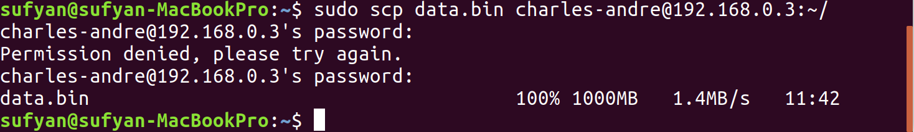
Now time to Test the New Protocol
Now implement system commands to adjust settings
Sudo sysctl -w net.ipv4.tcp_congestion_control=veno
Sudo sysctl -w net.ipv4.tcp_window_scaling=1
Sudo sysctl -w net.core.rmem_max=5242880
Sudo sysctl -w net.core.wmem_max=5242880
Create the file of 1GB if not made already
Dd if=/dev/urandom of=data.bin bs=1M count=1000
Create a network of 100Mbps/200ms/25%
We are now ready to test!
Sudo scp data.bin username@host_ip:/destination

Slide 9
Results
After implementing our new kernel we saw a throughput of 1.4MBps which translates to 11.2Mbps.
This lab was instrumental in allowing us play with linux kernels and learning how to make changes to an existing OS and not play by the rules of everyone else.
It was really cool to see how to edit a Kernel in general. It definitely took a long time, but opens up a world of possibilities in hacking new projects together.

